Slide 1
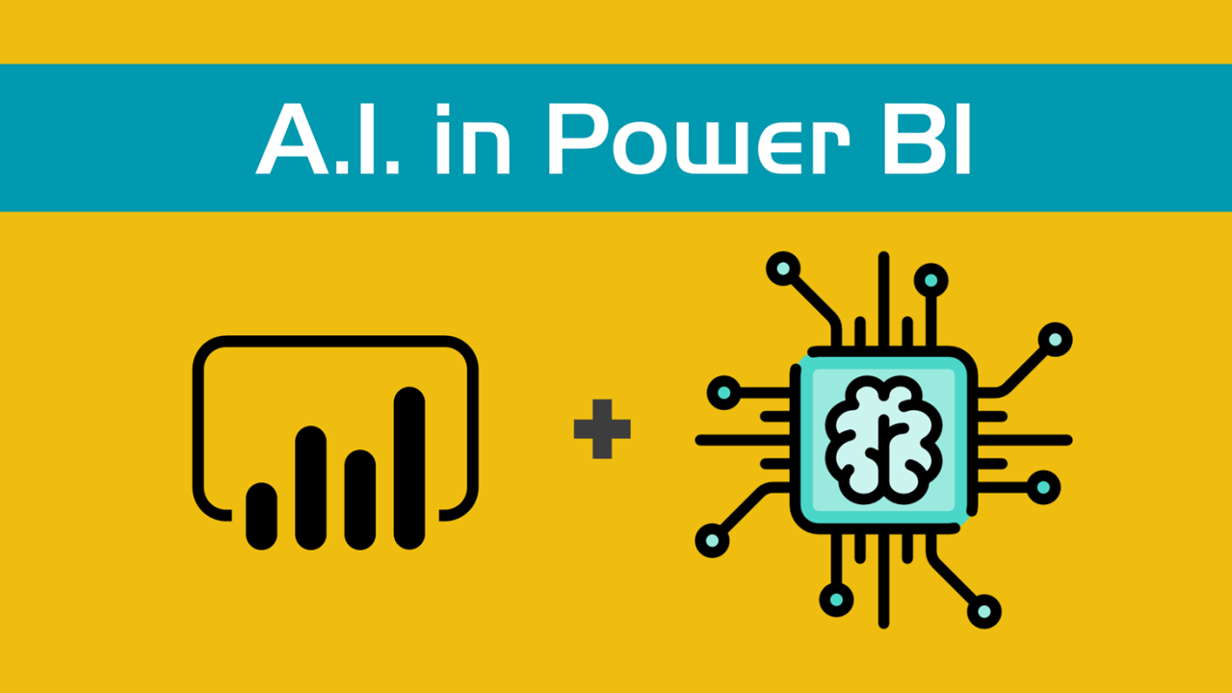
Power BI’s AI capabilities for quick insights

Slide 2
Power BI’s AI capabilities
Power BI's AI capabilities for Quick Insights leverage Microsoft's machine learning algorithms to provide users with automated data exploration and analysis. This feature identifies patterns, trends, anomalies, and correlations within a dataset to give users valuable insights without manually building complex queries or models.

Slide 3
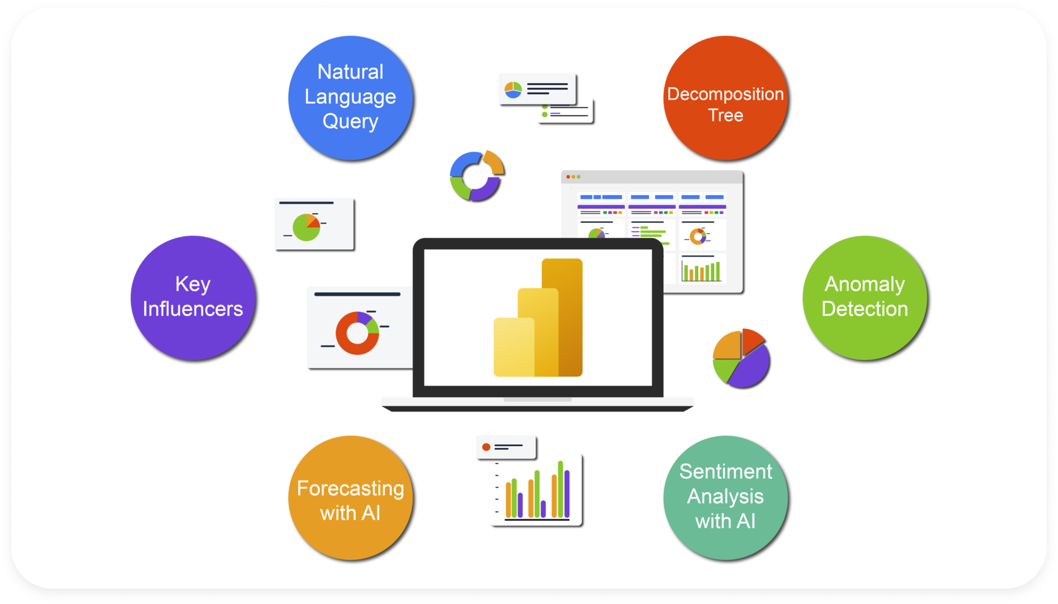
How Quick Insights works and some of the other ai-driven features in Power BI:
1. Quick Insights
Automatic Insight Generation: Quick Insights automatically analyzes data when it's loaded into Power BI and surfaces relevant findings, such as outliers, trends, major contributors, and correlations.
Custom Insight Selection: Users can specify areas or segments within the dataset to run Quick Insights, allowing for more targeted and relevant findings.
Integration with Power BI Service: Quick Insights is available on Power BI's cloud service, where you can activate insights and view results directly.

Slide 4

2. Smart narratives
Auto-Generated Explanations: Power BI's Smart Narratives automatically creates narratives and explanations for visual data insights, such as key drivers behind values and trends.
Customization: Users can adjust generated explanations to better align with specific needs and even add their own custom text.
Dynamic Updates: As data changes, narratives are updated, making this feature especially helpful for dashboard summaries.

Slide 5

3. Q&A and natural language processing (NLP)
Ask Questions About Data: Power BI’s Q&A feature lets users type questions in natural language, and the system returns visualizations or insights based on the query.
Real-Time Suggestions: While typing, Power BI suggests questions based on the dataset, helping users explore data more intuitively.
Customization: Dataset owners can customize Q&A responses by training the system to recognize synonyms or preferred phrasing.

Slide 6

4. Decomposition tree
Root Cause Analysis: The Decomposition Tree visual allows users to drill into data and understand contributing factors to a specific metric
AI Splits: The tool suggests AI-driven splits (e.g., "High Value," "Low Value") to direct users toward significant factors automatically.

Slide 7
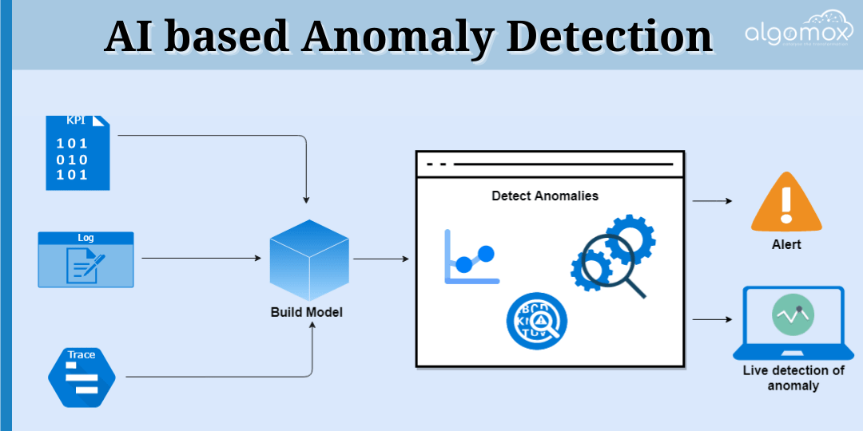
5. Anomaly detection
Identify Outliers: The anomaly detection feature highlights data points that deviate from expected patterns and offers explanations for potential causes
Custom Thresholds: Users can set parameters, such as the sensitivity level, to control how anomalies are detected.

Slide 8

6. Key influencers visual
Identify Key Drivers: This visual uses machine learning algorithms to determine the factors that influence specific metrics.
Segmentation: The tool breaks down data to show how various factors impact a metric differently across groups or categories.

Slide 9

7. Forecasting and time series analysis
Trend Forecasting: Power BI allows users to add forecasts to time series data with adjustable confidence intervals.
Automated Predictions: Using historical data, Power BI generates predictions, which can be useful for anticipating future trends in areas like sales or inventory.

Slide 10
Conclusion
In conclusion, Power BI’s AI capabilities for Quick Insights empower users to extract meaningful, data-driven insights rapidly and with minimal manual effort. Through features like automatic insights, natural language processing, anomaly detection, and key influencer analysis, Power BI simplifies data exploration and accelerates decision-making. These AI-driven tools enhance Power BI’s usability, making it accessible to users with varying levels of technical expertise, and provide valuable, actionable insights to guide strategic initiatives.

Slide 11


Thank you
ajaycraju98@gmail.com

